Slide 1
Anticonvulsants drugs
Asist. Prof. Dr. Jubran K. Hassan
Department of Clinical Pharmacy

Slide 2
Phenytoin
Clinical uses
is an anticonvulsant medication used for many types of seizure disorders. like tonic-clonic (grand mal) or partial seizures and for the acute treatment of generalized status epilepticus. As second line agent
Phenytoin is a type 1B antiarrhythmic and is also used in the treatment of trigeminal neuralgia
Mechanism of action
By inactivation of voltage-activated sodium ion channels and reduction the ability of neurons to ﬁre at high frequencies.

Slide 3
Phenytoin : Kinetics parameters
Bioavailability (F)
0.9 - 1 considered 100%
Salt Factor (S)
0.92 - Phenytoin Na⁺ (caps, IV)
1.0 - Phenytoin Acid (tabs, susp)
Protein Binding
90% , Fu=0.1
Volume of Distribution (Vd)
0.7L/Kg – Adults 1.0L/Kg - Children
Clearance (CL)
Vm= 7mg/kg/day ; Km =4mg/L (capacity limited)
Half life (t_{0.5})
8- 60 hrs ; aver. 22 hrs (conc. dependent)
Elimination
Hepatic – capacity limited metabolism (Zero order)
1-5% unchanged in urine
Cpss
10 -20 mg/L or 40-80 umol/L
Time to steady state
1 – 4 weeks (longer with higher doses )
Dosing (PO or IV only)
L.D = 15-18 mg/kg at max rate 50mg/min
M.D = 5 – 7 mg/kg /day in divided 2-3 doses

Slide 4
Phenytoin : Serum Conc. Related Side effects
10 mg/L
Usually no side effects
>15 mg/ L
Drawsiness , Fatigue
20 mg/L
Nystagmus esp. at lateral gaze
30mg /L
ataxia, slurred speech, and/or incoordination similar to ethanol intoxication can be observed
40 mg/L
severe confusion or lethargy, and coma are possible
50 -60 mg/L
Drug-induced seizure

Slide 5
Phenytoin : Monitoring problems
Alteration of protein binding
INSUFFICIENT ALBUMIN CONCENTRATION (HYPOALBUMINEMIA)
like nephrotic syndrome; is ever liver disease; pregnancy ..etc
DISPLACEMENT BY ENDOGENOUS COMPOUNDS
Like in hyperbilirubinemia & uremia
DISPLACEMENT BY EXOGENOUS COMPOUNDS
Like Drugs such as Warfarin , valproic acid , asprin >2g , NSAID with highly protein binding
When multiple factors that decrease phenytoin plasma protein binding are present in a patient, the free fraction can be as high as 30–40% and free concentration will be much elevated; and alter expected response from a given dose.

Slide 6
Phenytoin : Altered plasma protein binding
Unbound phenytoin serum concentrations should be measured in patients with factors known to alter phenytoin plasma protein binding.
For interpretation of plasma concentration of phenytoin is better to correct the observed plasma concentration with low binding to plasma concentration at normal conditions, this will make less calculation errors
equation for correction is:
$$Cnormal Binding=\frac{C^{′}}{\left(1−fu\right)\left[\frac{P^{′}}{Pnl} \right]+fu}$$
Or
$$Cnormal Binding=\frac{Observed Phenytoin conc.}{\left(1−0.1\right)\left[\frac{Patient serum albumin}{4.4g/dl} \right]+0.1}$$

Slide 7
Phenytoin : Altered plasma protein binding
$$Cnormal Binding=\frac{Observed Phenytoin conc. in µg/ml}{\left(0.9\right)\left[\frac{Patient serum albumin}{4.4g/dl} \right]+0.1}$$
The value of $\left(0.9\right)\left[\frac{1}{4.4g per dl}\right]=0.2$ _{at 37 C}⁰ or 0.25 _{at 25 C}⁰
The value could represented as X
Then the equation will be
$$Cnormal Binding=\frac{Observed Phenytoin conc. in µg/ml}{\left(X\right)(Patient serum albumin)+0.1}$$
in most clinical laboratories protein binding is determined at room temperature (25°C) so X will be 0.25
X will be multiply by 0.48 if there is ureamia or end stage renal failure (creatinine clearance <10–15 mL/min ) and could be = 0.1

Slide 8
Phenytoin : Altered plasma protein binding
Then the final equation will be
$$Cnormal Binding=\frac{Observed Phenytoin conc. in µg/ml}{\left(X\right)(Patient serum albumin)+0.1}$$
X= 0.25 at 25C⁰ in case of hypoalbuminemia
X= 0.1 at 25C⁰ in case of hypoalbuminemia & renal impairement
In case of drug displace phenytoin from protein binding site is difficult to estimate extent of drug displacement since conc. Of displacing agent is unknown except if phenytoin and valproic acid are monitored together. Especially if valproic acid serum conc.>20mg/L
Then the final equation will be
$$Cnormal Binding=\frac{[(0.095 + 0.001 ⋅ VPA)][Observed Phenytoin conc. in µg per ml]}{0.1}$$
VPA conc. in $µg per ml$

Slide 9
Phenytoin : Altered plasma protein binding
Example 1 JM is an epileptic patient on phenytoin. He has serum (albumin = 2.2 g/dL) and creatinine clearance 90 mL/min). His total phenytoin concentration is 7.5 μg/mL. Assuming that any unbound concentrations performed by the clinical laboratory will be conducted at 25°C, A- Compute an estimated normalized phenytoin concentration for this patient.
Answer : use equation to correct plasma conc. of phenytoin to normal binding.
X =0.25 at 25C⁰ . The patient creatinine clearance arround normal >15 ml/min . And valproic acid was not concomitantly used ; so the equation selected is
$$Cnormal Binding=\frac{Observed Phenytoin conc. in µg/ml}{\left(X\right)(Patient serum albumin)+0.1}$$
= 7.5 μg/mL /[ (0.25* 2.2g/dl)+0.1]
= 11.5 μg/mL
and C _{free} = C_{total .}Fu then 11.5* 0.1= 1.15 μg/mL

Slide 10
Phenytoin : Altered plasma protein binding
Example 1 B- Compute an estimated normalized phenytoin concentration for this patient. If creatinine clearance was 10ml/min
Answer : use equation to correct plasma conc. of phenytoin to normal binding.
X =0.1 at 25C⁰ . The patient creatinine clearance <15 ml/min. And valproic acid was not concomitantly used ; so the equation selected is
$$Cnormal Binding=\frac{Observed Phenytoin conc. in µg/ml}{\left(X\right)(Patient serum albumin)+0.1}$$
= 7.5 μg/mL /[ (0.1* 2.2g/dl)+0.1]
= 23.4 μg/mL
and C _{free} = C_{total .}Fu then 23.4* 0.1= 2.34 μg/mL

Slide 11
Phenytoin : Altered plasma protein binding
Example 2 PM is an epileptic patient being treated with phenytoin and valproic acid. He has a normal albumin concentration (albumin = 4.2 g/dL) and normal renal function (creatinine clearance = 90 mL/min). His steady-state total phenytoin and valproic acid concentrations are 7.5 μg/mL and 100 μg/mL, respectively.. A- Compute an estimated normalized phenytoin concentration for this patient.
Answer : use equation to correct plasma conc. of phenytoin to normal binding.
The patient creatinine clearance arround normal >15 ml/min . And valproic acid was concomitantly used ; so the equation selected is
$$Cnormal Binding=\frac{[(0.095 + 0.001 ⋅ VPA)][Observed Phenytoin conc. in µg per ml]}{0.1}$$
= [(0.095+0.001* 100)][7.5]/0.1 = 15 μg/mL
and C _{free} = C_{total .}Fu then 15* 0.1 = 1.5 μg/mL

Slide 12
Phenytoin : Volume of distribution
Volume of distribution : if plasma protein & renal function are normal ; is estimated as 0.65L/kg for non obese patient.
While for obese patient the Vd is corrected as follow equation:
Vd=0.7L/kg * [IBW+1.3(TBW-IBW)]
IBW is ideal body weight in kilograms
IBW(in kg) = G_{f} *(50) + 2.3(Ht_{(inches)} − 60)
G_{f} =gender factor =1 for male and 0.9 for female
Again any plasma concentration observed under altered plasma protein binding should be corrected to concentration under normal protein binding
Phenytoin Vd is unaffected by saturable metabolism and is still determined by the physiological volume of blood (VB) and tissues (VT) as well as the unbound concentration of drug in the blood (fB) and tissues (fT): Vd = VB+ (fB/fT)VT.

Slide 13
Phenytoin : Clearance
by hepatic metabolism (>95%).
mainly via the CYP2C9 enzyme system with a smaller amount metabolized by CYP2C19.
About 5% of a phenytoin dose is excreted in urine as unchanged drug.
Phenytoin follows Michaelis-Menten or saturable pharmacokinetics.
This is the type of nonlinear pharmacokinetics that occurs when the number of drug molecules >> enzyme’s ability to metabolize the drug.
Here, C_{SS} increase in a disproportionate manner after a dosage increase
To find out Clearance of phenytoin re- arrangement of Michaelis-Menten equation is required

Slide 14
Phenytoin : Clearance
Where dX/dt $=\frac{\left(Vmax\right)\left(CSS ave\right)}{Km+CSS ave}$
Vmax = is the maximum rate of metabolism in mg/d
Km = Km is the substrate concentration in mg/L, and where the rate of metabolism = 0.5 *Vmax
Css = average steady-state phenytoin concentration.
dX/dt = the change in the amount of drug (X) over time (t), can be expressed
as X₀/dt (dose over dosing interval) or can be expressed as (S)(F)(Dose)/T
So
$(S)(F)(dose)/T=\frac{\left(Vmax\right)\left(CSS ave\right)}{Km+CSS ave}$ _{Since}
$\frac{\left(s\right)\left(F\right)\left(dose\right)}{T}=(CL)(Css ave)$ so $Clphenytoin=\frac{\left(Vmax\right)}{Km+CSS ave}$

Slide 15
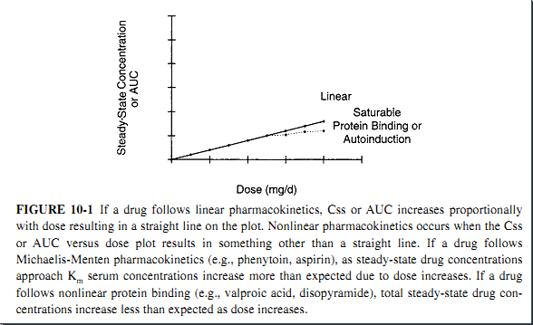
Phenytoin : Clearance
Michael-Menten
So $(S)(F)(dose)/T=\frac{\left(Vmax\right)\left(CSS ave\right)}{Km+CSS ave}$ Represents maintenance dose of
phenytoin at steady state (M.D)
Phenytoin could follow first order kinetic if the Css << Km so that it could be negligible $\frac{\left(S\right)\left(F\right)\left(dose\right)}{T}=\frac{\left(Vmax\right)}{Km}css ave$ here V_{max}/Km =CL

Slide 16
Phenytoin : Dosage form, S & F factors effects
Phenytoin
Parenterally
Orally
BY N.G tube
Phenytoin Na⁺
FosPhenytoin
Phenytoin Na⁺
Phenytoin
-↓ absorbition of oral dosage forms
S=0.92
P.E=0.92*
S=0.92
S=1
relatively insoluble in water
Phosphate Ester salt soluble in water
-Extended release cap
F=100%
-Tablets
Suspension
F=100%
-Possibly due to:
-↓Gastrointestinal transit time
-binding to proteins In Enteral feeding
Solvent is propylen glycol or ethanol
Solvent is Water
1-2 dose/day
≥2 dose/day
PH 10 - 12
Cause
IV =NO Hypotension
IM= Rapid absorption No pain
Changes in dosage form will provide different plasma concentration; so they need dose calculation or they are non interchangible
Cause
IV = Hypotension IM= Preceptation & pain
-Solution:
-Stop feeding 1-2 hr before & after Phenytoin administration
F IV=100%
F IM= variable
F IV=IM=100%

Slide 17
Phenytoin : Impact of altered plasma protein binding on phenytoin pharmacokinetics
$Cl Hepatic=QH.\frac{\left(fu\right)\left(Clint\right)}{QH + \left(fu\right)\left(Clint\right)}$
Phenytoin is low extracted E_{R}<30% so $QH$>>$\left(fu\right)\left(Clint\right)$
So $Cl Hepatic=QH.\frac{\left(fu\right)\left(Clint\right)}{QH }$ = $\left(fu\right)\left(Clint\right)$
So if $\left(fu\right)$of phenytoin is elevated this will result in
$$QH$$
↔
$$Clint$$
↔
$$fu$$
↑
$$Cl$$
↑
$$Cl= \left(fu\right)\left(Clint\right)$$
↑
↑
$$Vd$$
↑
$Vd=Vblood+( fublood/futissue$). $Vtissue$
↑
↑
$$t0.5$$
↔
$$t0.5=0.693 Vd /CL$$
↔
↑
↑
$$Css$$
↓
↑
$$M.D= Cssave. CL$$
↔
↓
$Css$ _{Unb}
↔
$$Css unb= Css .fu$$
↔
↓
↑
$$Effect$$
↔

Slide 18
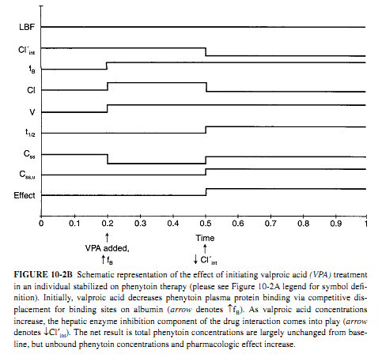
Phenytoin : Impact of Valproic acid on phenytoin pharmacokinetics

Slide 19
Phenytoin : Dosage determination methods
Pharmacokinetic method by Mechaelis -Menten equation
If the patient has normal liver & renal function , & with normal plasma protein binding . Using already estimated Vmax and Km values
Age group
Vmax
Km
Adult
7mg/kg/day
4 mg/L
6 months–6 years
12mg/kg/day
6 mg/L
7 –16 years
9mg/kg/day
6 mg/L
Example 1 TD is a 50-year-old, 75-kg (5 ft 10 in) male with simple partial seizures who requires therapy with oral phenytoin. He has normal liver and renal function. Suggest an initial phenytoin dosage regimen designed to achieve a steady-state phenytoin concentration equal to 12 μg/mL.
Answer Patient was non obese, using adult values of Vmax and Km
Vmax=7mg/kg/day *75 kg=525 mg/day Km=4mg/L
Convert 12 μg/mL to mg/L =12mg/Liter
M.D=Vmax.css/Km+css= (525)(12)/(4+12)=6300/16=393.75 mg/day of phenytoin
Select dosage form & salt = Use phenytoin cap contains Na salt S=0.92,F=1
So dose of capsule /day == 393.75/(1)(0.92) = 428mg/day ≈ 400mg/day

Slide 20
Phenytoin : Dosage determination methods
Pharmacokinetic method by Mechaelis -Menten equation
Example 2 UO is a 10-year-old, 40-kg male with simple partial seizures who requires therapy with intravenous fosphenytoin. He has normal liver and renal function. Suggest an initial phenytoin dosage regimen designed to achieve a steady-state phenytoin concentration equal to 12 μg/mL.
Answer Patient was non obese, using adult values of Vmax and Km
Vmax=9mg/kg/day *40 kg= 360 mg/day Km=6mg/L
Convert 12 μg/mL to mg/L =12mg/Liter
Vd=0.65≈0.7L/kg =0.7*40 = 28 Liters
LD= Vd* Css desired == 28*12=336mg of phenytoin =336/(0.92)(1)=365mg≈ 350mg/day of fosphenytoin could be given in rate 150 mg/min
M.D=Vmax.css/Km+css= (360)(12)/6+12=4320/18=240 mg/day of phenytoin
Select dosage form & salt = Use fosphenytoin inj. S=0.92,F=1
So dose /day == 240/(1)(0.92) = 261mg/day ≈ 250mg/day
Fospheytoin could be given as 125 mg bid to the patient
Re check required after 7 -14 day after achieve css

Slide 21
Phenytoin : Dosage determination methods
Literature-Based Recommended Dosing
many clinicians believe that the use of standard phenytoin doses for various situations are warranted. That due to great variability in phenytoin pharmacokinetics.
Target plasma conc. 10–15 μg/mL.
Suggested phenytoin maintenance doses are 4–6 mg/kg/d for adults
for children (6 months–16 years old) dose is 5–10 mg/kg/d .
Phenytoin loading doses are 15–20 mg/kg.
For obese individuals (>30% over ideal body weight), adjusted body weight (ABW) should be used to compute loading doses
Example 1 TD is a 50-year-old, 75-kg (5 ft 10 in) male with simple partial seizures who requires therapy with oral phenytoin. He has normal liver and renal function. Suggest an initial phenytoin dosage regimen designed to achieve a steady-state phenytoin concentration equal to 12 μg/mL.
Answer Patient was non obese, initial dosage rate 4–6 mg/kg/d. Using a rate of 5 mg/kg/d,
5 * 75 kg=375 mg/day of phenytoin
Select dosage form & salt = Use phenytoin cap contains Na salt S=0.92,F=1
So dose of capsule /day == 375/(1)(0.92) = 408mg/day ≈ 400mg/day

Slide 22
Phenytoin : Dosage determination methods
Literature-Based Recommended Dosing
Example 2 UO is a 10-year-old, 40-kg male with simple partial seizures who requires therapy with intravenous fosphenytoin. He has normal liver and renal function. Suggest an initial phenytoin dosage regimen designed to achieve a steady-state phenytoin concentration equal to 12 μg/mL.
Answer Patient was non obese, The suggested initial dosage rate for fosphenytoin injection in an adolescent patient is
5–10 mg/kg/d PE. Using a rate of 6 mg/kg/d,
6*40= 240 mg/day
Convert 12 μg/mL to mg/L =12mg/Liter
Vd=0.65≈0.7L/kg =0.7*40 = 28 Liters
So dose /day == 240/(1)(0.92) = 261mg/day ≈ 250mg/day
Fospheytoin could be given as 125 mg bid to the patient
Re check required after 7 -14 day after achieve css

Slide 23
Phenytoin : Dosage Alteration methods
Single Total Phenytoin Steady-State Serum Concentration Methods
Empiric dosing method
Based on the knowledge of population Michaelis-Menten pharmacokinetic parameters, itis possible to suggest empiric dosage increases for phenytoin when one steady-state serum concentration is available using following table
Phenytoin conc. mg/L
Suggested Dosage increase
<7
100 mg/day or more
7 -12
50 -100 mg/day
>12
30 -50 mg/day
Example 1 TD is a 50-year-old, 75-kg (5 ft 10 in) male with simple partial seizures who requires therapy with oral phenytoin. He has normal liver and renal function. he used 400mg/day capsule for 1 month and on visit measured steady-state phenytoin total concentration equals 6.2 μg/mL . Suggest an initial phenytoin dosage regimen designed to achieve a steady-state phenytoin concentration within the therapeutic range.
Answer plasma equals to 6.2 μg/mL ;according to the table the dose should be increase by at least 100mg/day to be 500 mg /day
Patient should be reassessed after 7-14 days

Slide 24
Phenytoin : Dosage Alteration methods
Single Total Phenytoin Steady-State Serum Concentration Methods
Pseudo linear pharmacokinetic method
simple, easy way to approximate new total serum concentrations of phenytoin
temporarily assume linear pharmacokinetics
then add 15–33% for a dosage increase or subtract 15–33% for a dosage decrease to account for Michaelis-Menten pharmacokinetics: Css_{new} = (D_{new} / D_{old}).Css _{old}
The pseudolinear pharmacokinetics method should never be used to compute a new dose based on measured and desired phenytoin concentrations.
Answer example 1 since plasma equals to 6.2 μg/mL<10 μg/mL ; add 15–33% for a dosage (use 25% of old dose) the new dose will be 100+400 =500mg/day
the resulting total steady-state phenytoin serum concentration would equal: Cssnew = (Dnew / Dold)Cssold = (500 mg/d / 400 mg/d)6.2 μg/mL =7.8 μg/mL. if it is linear.
Because of Michaelis-Menten pharmacokinetics, the serum concentration
would be expected to increase 15%, or 1.15 times, to 33%, or 1.33 times
1.15*7.8=9 μg/mL 1.33*7.8= 10.4 μg/mL
So increment of dose by 100mg/day will expected to produce conc range 9-10.4 μg/mL
Patient should be reassessed after 7-14 days

Slide 25
Phenytoin : Dosage Alteration methods
Single Total Phenytoin Steady-State Serum Concentration Methods
GRAVES-CLOYD METHOD
Is to compute the patient’s own phenytoin clearance rate
D_{new} = (D_{old} / C_{ssold}) ⋅ C_{ssnew}^{0.199} ⋅ C_{ssold}^{0.804}
Answer example 1 since plasma equals to 6.2 μg/mL ; desired conc is10 μg/mL
Phenytoin sodium 400 mg equals 368 mg of phenytoin (400 mg ⋅ 0.92 = 368 mg)
= (368 mg/d / 6.2 mg/L) (10 mg/L)^{0.199}⋅ (6.2 mg/L)^{0.804}
= 407 mg/d of phenytoin = 407 mg/d /0.92=442mg/day phenytoin sodium
rounded to 450 mg/d, or 400 mg/d on even days alternating with 500 mg/d on odd days.

Slide 26
Phenytoin : Dosage Alteration methods
Single Total Phenytoin Steady-State Serum Concentration Methods
VOZEH-SHEINER OR ORBIT GRAPH METHOD
A graphical method that employs population Michaelis-Menten information using Bayes’theorem can also be used to adjust phenytoin doses using a single steady-state total concentration.
Example S.B is 37 years old ,70 kg man with seizure that only partially controlled by using 300mg /day of phenytoin capsules. His plasma concentration found 8 mg/Liter . Calculate maintenance dose to achieve css of 15 mg/liter. using orbit graph method
Answer
conc. (X= 8mg/liter) (s)(F)(dose)/T )(0.92)(1) (300mg/day)=276m g/day
==276 mg/ day of phenytoin =276/70kg= 3.94mg/kg/ day
Rate of administration (Y= 3.94mg/kg/ day)
Determine these data on x, y axis
Then plot a line (A) pass through these data to inter most of orbit (closer to the center as possible
Specify B point by making B= 15 mg/ liter on X axis application
Draw line B that intercept with y axis and Line A at the inter most of orbit
Point of intersection of line A&B will be the point from drop aline on X-axis to find out Km value , & on Y axis to find vmax value

Slide 27
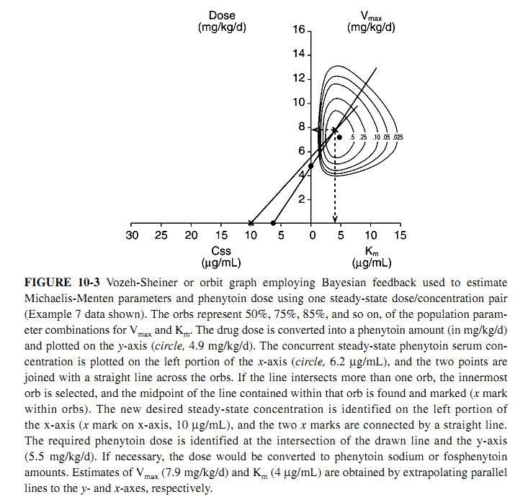
Phenytoin : Dosage Alteration methods
Rate of administration (mg/kg/day)
Vmax
(mg/kg/day)
12
10
8
.
.5
.75
.9
.95
.975
Vm =6.4mg/kg/day
6
New Dose rate =4.85 mg/kg/day
4
X
B
Km =5mg/Liter
2
A
X
X
24
20
16
12
8
4
0
4
8
12
16
Css (ug/ml)
Km (ug/ml)

Slide 28
Phenytoin : Dosage Alteration methods
Single Total Phenytoin Steady-State Serum Concentration Methods
VOZEH-SHEINER OR ORBIT GRAPH METHOD
Answer
By application in Michaelis Menten Equation we found
(0.92)(1)(dose/T) =6.4*70kg*15mg/(5 +15) =365mg/day of phenytoin Na
Another method
Also from interception of line B with y axis; the value of interception point represents Dosing rate =4.8mg/kg/day of phenytoin =
(0.92)(1)(dose/T) = 4.8*70=365 mg/day phenytoin sodium

Slide 29
Phenytoin : Dosage Alteration methods
Two or More Phenytoin Steady-State Serum Concentrations
at Two or More Dosage Levels Methods
EMPIRIC DOSING METHOD
Using (Table 10-4).or table in slide 23 to estimate new dosage regimen after estimation of plasma conc. attained from 2 dosage
Example 1 GF is a 35-year-old, 55-kg female with tonic-clonic seizures who requires therapy with oral phenytoin. She has normal liver and renal function. The patient was prescribed 300 mg/d of extended phenytoin sodium capsules for 1 month, and the steady-state phenytoin total concentration equals 10.7 μg/mL. At that time, the dose was increased to 350 mg/d of extended phenytoin sodium capsules for an additional month, and the resulting steady state concentration was 15.8 mg/mL. The patient is assessed to be compliant with her dosage regimen. Suggest a new phenytoin dosage regimen increase designed to achieve a steady-state phenytoin concentration within the upper end of the therapeutic range.
Answer The next logical dose to prescribe is phenytoin sodium 400 mg/d (Table 10-4).
A steady-state trough total phenytoin serum concentration should be measured after steady state is attained in 7–14 days. Phenytoin serum concentrations should also be measured if the patient experiences an exacerbation of their epilepsy, or if the patient develops potential signs or symptoms of phenytoin toxicity.

Slide 30
Phenytoin : Dosage Alteration methods
Two or More Phenytoin Steady-State Serum Concentrations
at Two or More Dosage Levels Methods
MULLEN METHOD
This dosage approach uses the same dose/concentration plot as that described for the Vozeh-Sheiner or orbit graph method, but the population orbs denoting the Bayesian distribution of Vmax and Km parameters are omitted.
Example 3 TD is a 50-year-old, 75-kg (5 ft 10 in) male with simple partial seizures who requires therapy with oral phenytoin. He has normal liver and renal function. The patient was prescribed 400 mg/d of extended phenytoin sodium capsules for 1 month, and the steady-state phenytoin total concentration equals 6.2 μg/mL. The dosage was increased to 500 mg/d of extended phenytoin sodium capsules for another month, the steady state phenytoin total concentration equals 22.0 μg/mL, and the patient has some lateral-gaze nystagmus. The patient is assessed to be compliant with his dosage regimen.
Suggest a new phenytoin dosage regimen designed to achieve a steady-state phenytoin
concentration within the therapeutic range.
Using the graph, the serum concentration/dose information is plotted.
Convert all dosing rate to dose rate per kg and assign the point of conc. on X axis And Dosing rate on Y axis
Draw line between each dose rate and it related

Slide 31
Phenytoin : Dosage Alteration methods
MULLEN METHOD
Each line drawn should pass to the sector of Km value
Point of intersection of these line represents the point of determination of Km (by drop line on X-axis and used to determine Vmax by plot line to y axis
Then data of Km & vmax could be used to calculate the dosage of new desired conc.
Or plotting a line(line C ) from point of desired plasma conc. On x-axis to the point of determination , the point of intercept will represent new dosage rate
Answer
Convert dosing rate to dose per kg (s)(F)(dose/T) /weight
(0.92)(1)(400mg/day)/75= 4.9mg/kg/day produce conc. 6.2 mg/L
(0.92)(1)(500mg/day)/75= 6.1mg/kg/day produce conc. 22 mg/L
According to the graph, a dose of 5.5 mg/kg/d of phenytoin is required to achieve a steady-state concentration equal to 11.5 μg/mL. This equals an extended phenytoin sodium capsule dose of 450 mg/d,
administered by alternating 400 mg/d on even days and 500 mg/d on odd days:
(5.5 mg/kg/d ⋅ 75 kg) / 0.92 = 448 mg/d, rounded to 450 mg/d. Vmax = 6.8 mg/kg/d and Km = 2.2 μg/mL for this patient.

Slide 32
Phenytoin : Dosage Alteration methods
Rate of administration (mg/kg/day)
Vmax
(mg/kg/day)
12
10
8
New Dose rate =5.5 mg/kg/day
Vm =6.8mg/kg/day
X
6
X
4
B
Km =2.2mg/Liter
C
2
A
X
X
X
24
20
16
12
8
4
0
4
8
12
16
Css (ug/ml)
Km (ug/ml)

Slide 33
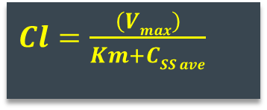
Phenytoin : Dosage Alteration methods
Two or More Phenytoin Steady-State Serum Concentrations
at Two or More Dosage Levels Methods
LUDDEN METHOD
This method involves the arrangement of the Michaelis-Menten equation so that two or more maintenance doses (MD, in mg/d of phenytoin) and steady-state concentrations (Css in mg/L = μg/mL) can be used to obtain graphical solutions for Vmax and Km
$M.D=\frac{\left(Vmax\right)\left(CSS ave\right)}{Km+CSS ave}$
$M.D/\left(CSS ave\right)=\frac{\left(Vmax\right)}{Km+CSS ave}$
$Cl=\frac{\left(Vmax\right)}{Km+CSS ave}$
$Cl.Km+Cl.CSS ave=Vmax$
$Cl.Km+M.D=Vmax$
$$M.D=−Cl.Km+Vmax$$
$$M.D=−Km.[M.D/\left(CSS ave\right)]+Vmax$$
$$Y =m. X + b$$

Slide 34
Phenytoin : Dosage Alteration methods
Two or More Phenytoin Steady-State Serum Concentrations
at Two or More Dosage Levels Methods
LUDDEN METHOD
Example 3 TD is a 50-year-old, 75-kg (5 ft 10 in) male with simple partial seizures who requires therapy with oral phenytoin. He has normal liver and renal function. The patient was prescribed 400 mg/d of extended phenytoin sodium capsules for 1 month, and the steady-state phenytoin total concentration equals 6.2 μg/mL. The dosage was increased to 500 mg/d of extended phenytoin sodium capsules for another month, the steady state phenytoin total concentration equals 22.0 μg/mL, and the patient has some lateral-gaze nystagmus. The patient is assessed to be compliant with his dosage regimen.
Suggest a new phenytoin dosage regimen designed to achieve a steady-state phenytoin concentration within the therapeutic range.
Answer Because only two dose/steady-state concentrations pairs are available, a direct mathematical solution can also be conducted: −Km(slope) = (MD1 − MD2) / [(MD1/Css1) − (MD2/Css2)] =(460 mg/d − 368 mg/d) / [(460 mg/d / 22 mg/L) − (368 mg/d / 6.2 mg/L)] = −2.4 mg/L, Km =2.4 mg/L; Vmax = MD + Km(MD/Css) = 368 mg/d + 2.4(368 mg/d / 6.2 mg/L) = 510 mg/d.
Lets consider the desired plasma conc. Is 10.4 mg/L; then by application of data of Css, New Vmax, Km In mechaelis menten equation the dose will be 450 mg/day

Slide 35
Phenytoin : Dosage Alteration methods
Two or More Phenytoin Steady-State Serum Concentrations
at Two or More Dosage Levels Methods
LUDDEN METHOD
Answer Also BY plotting data Dose in mg/day of phenytoin on Y axis and dose/css on x axis then graphically determine Vmax & Km
Using the graph, the serum concentration/dose information is plotted. (Note: Phenytoin dose = 0.92 ⋅
phenytoin sodium dose = 0.92 ⋅ 400 mg/d = 368 mg/d; produce conc. of 6.2 mg/L
Cl=MD/Cssave =368/6.2=59.4L/d
0.92 ⋅ 500 mg/d = 460 mg/d, produce conc. Of 22mg/L
Cl=MD/Cssave = 460/22= 20.9L/d
According to the graph, Vmax =510 mg/d and Km = 2.4 mg/L.
Lets consider the desired plasma conc. Is 10.4 mg/L; then by application of data of Css, New Vmax, Km In mechaelis menten equation the dose will be 450 mg/day
BAYESIAN PHARMACOKINETIC COMPUTER PROGRAMS

Slide 36
Phenytoin : Dosage Alteration methods
Y Intercept = Vmax = 510mg/day
600
500
(460 ;20.9)
X
400
(368 ;59.4)
Dose in (mg/day)
X
-Slope= Km =2.4mg/Liter
300
200
100
10
20
30
40
50
60
Clearance (dose/Css)

Slide 37
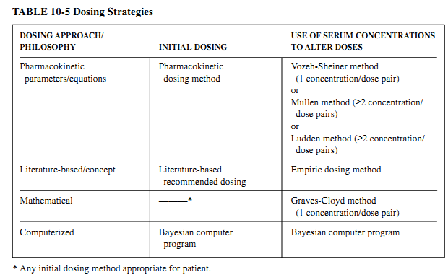
Phenytoin : Dosage Alteration methods
BAYESIAN PHARMACOKINETIC COMPUTER PROGRAMS
Summary of dosing strategies

Slide 38
Phenytoin : Booster doses to immediately increase serum conc.
If a patient has a sub-therapeutic phenytoin serum concentration in an acute situation, it may be desirable to increase the phenytoin concentration as quickly as possible. In this setting, it would not be acceptable to simply increase the maintenance dose and wait for therapeutic steady-state serum concentrations to be established in the patient. A rational way to increase
BD = [(C_{desired} − C_{actual})V] / S
Volume of distribution should be corrected for For obese individuals 30% or more above their ideal body weight using following equation
Vd=0.7L/kg * [IBW+1.3(TBW-IBW)]
IBW is ideal body weight in kilograms
IBW(in kg) = G_{f} *(50) + 2.3(Ht_{(inches)} − 60)
G_{f} =gender factor =1 for male and 0.9 for female

Slide 39
Thank you

